Slide 1
Topics to be Covered
Graphs – Some definitions
Graphs Representation
Planar graphs

Slide 2
Introduction
What is a graph G?
It is a pair G = (V, E), where
  V = V(G) = set of vertices or nodes
  E = E(G) = set of edges or arcs

Slide 3
Graphs
Example: G=(V,E) where
  V = {s, u, v, w, x, y, z}
  E = {(x,s), (x,v)₁, (x,v)₂, (x,u), (v,w), (s,v), (s,u), (s,w), (s,y), (w,y), (u,y), (u,z),(y,z)}
Vertex or node
v
w
x
y
s
u
z
Edge or arc

Slide 4
Edges
An edge may be labeled by a pair of vertices, for instance e = (v,w).
e is said to be incident on v and w.
Isolated vertex = a vertex without incident edges.
w
isolated vertex
e
v

Slide 5
Special edges – Parallel edges
Parallel edges
  Two or more edges joining a pair of vertices
    in the example, v and w are joined by two parallel edges
w
f
e
v

Slide 6
Special edges – Loops
  An edge that starts and ends at the same vertex
    In the example, vertex x has a loop
loop
w
g
f
e
x
h
v

Slide 7
Special graphs - Simple graph
A graph without loops or parallel edges.
v
w
x
y
s
u
z

Slide 8
Special graphs - Weighted graph
A graph where each edge is assigned a numerical label or “weight”.
v
2
w
1
x
5
5
6
7
3
y
s
1
8
u
z

Slide 9
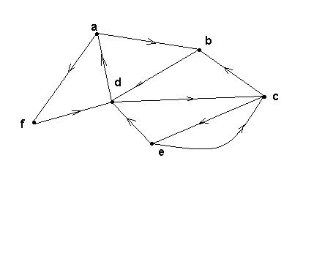
Directed graphs (digraphs)
G is a directed graph or digraph if each edge has been associated with an ordered pair of vertices, i.e. each edge has a direction

Slide 10
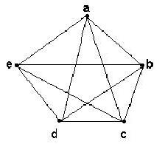
Complete graph K_{n}
Let n > 3
The complete graph K_{n} is the graph with n vertices and every pair of vertices is joined by an edge.
The figure represents K₅

Slide 11
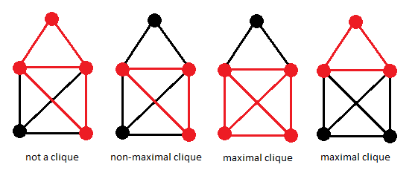
Clique
A clique, C, in an undirected graph G = (V, E) is a subset of the vertices, C ⊆ V, such that every two distinct vertices are adjacent. The induced subgraph of G induced by C is a complete graph.
In some cases, the term clique may also refer to the subgraph directly.
G
not a clique
clique
clique
clique

Slide 12
Clique
A maximal clique is a clique that cannot be extended by including one more adjacent vertex, that is, a clique which does not exist exclusively within the vertex set of a larger clique. Some authors define cliques in a way that requires them to be maximal.
G
not a clique
non-maximal clique
maximal clique
maximal clique

Slide 13
Clique
A maximum clique of a graph, G, is a clique, such that there is no clique with more vertices. Moreover, the clique number ω(G) of a graph G is the number of vertices in a maximum clique in G.
G
not a clique
non-maximal clique
maximum clique
maximal clique

Slide 14
Clique
The intersection number of G is the smallest number of cliques that together cover all edges of G.
The clique cover number of a graph G is the smallest number of cliques of G whose union covers the set of vertices V of the graph.
A maximum clique transversal of a graph is a subset of vertices with the property that each maximum clique of the graph contains at least one vertex in the subset.

Slide 15
Clique
The opposite of a clique is an independent set, in the sense that every clique corresponds to an independent set in the complement graph.
The clique cover problem concerns finding as few cliques as possible that include every vertex in the graph.
A related concept is a biclique, a complete bipartite subgraph. The bipartite dimension of a graph is the minimum number of bicliques needed to cover all the edges of the graph.

Slide 16
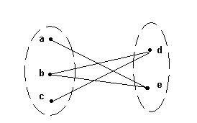
Bipartite graphs
A bipartite graph G is a graph such that
  V(G) = V(G₁) ∪ V(G₂)
  |V(G₁)| = m, |V(G₂)| = n
  V(G₁) ∩V(G₂) = ∅
  No edges exist between any two vertices in the same subset V(G_{k}), k = 1,2

Slide 17
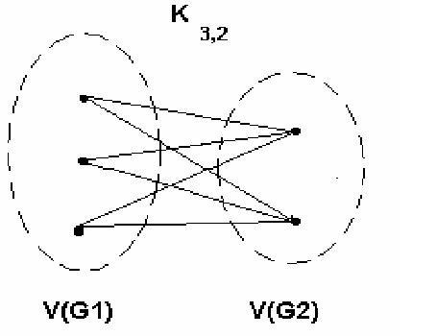
Complete bipartite graph K_{m,n}
A bipartite graph is the complete bipartite graph K_{m,n} if every vertex in V(G₁) is joined to a vertex in V(G₂) and conversely,
|V(G₁)| = m
|V(G₂)| = n

Slide 18
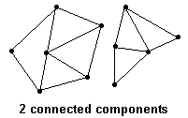
Connected graphs
A graph is connected if every pair of vertices can be connected by a path
Each connected subgraph of a non-connected graph G is called a component of G

Slide 19
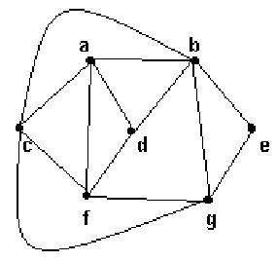
Planar graphs
A graph is planar if it can be drawn in the plane without crossing edges

Slide 20
Euler’s formula
If G is planar graph,
  v = number of vertices
  e = number of edges
  f = number of faces, including the exterior face
Then: v – e + f = 2
Interior face
f₂
f₁
Exterior face

Slide 21
Planarity
Is the K_{3,3} graph planar?

Slide 22
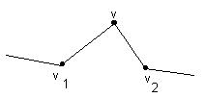
Edges in series
Edges in series:
If v ∈ V(G) has degree 2 and there are edges (v, v₁), (v, v₂) with v₁ ≠ v₂,
we say the edges (v, v₁) and (v, v₂) are in series.

Slide 23
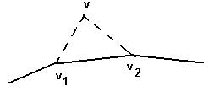
Series reduction
A series reduction consists of deleting the vertex v ∈ V(G) and replacing the edges (v,v₁) and (v,v₂) by the edge (v₁,v₂)
The new graph G’ has one vertex and one edge less than G and is said to be obtained from G by series reduction

Slide 24
Homeomorphic graphs
Two graphs G and G’ are said to be homeomorphic if G’ is obtained from G by a sequence of series reductions.
  By convention, G is said to be obtainable from itself by a series reduction, i.e. G is homeomorphic to itself.
Define a relation R on graphs: GRG’ if G and G’ are homeomorphic.
R is an equivalence relation on the set of all graphs.

Slide 25
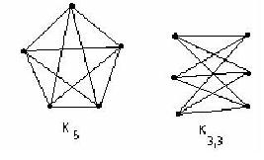
Kuratowski’s theorem
G is a planar graph if and only if G does not contain a subgraph homeomorphic to either K ₅ or K _{3,3}

Slide 26
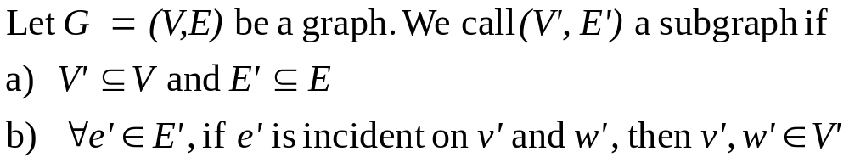
Subgraph
v₁
v₁
v₂
v₃
v₃
Graph G
Subgraph G’

Slide 27
Example
Show that the graph G of Figure 8.7.6 is not planar by using Kuratowski’s Theorem.
a
b
f
g
h
e
c
d

